Slide 1
Deploying applications in kubernetes

Slide 2
Background – Docker, Containers, and Orchestrators
Short Answers
Containers are like “Lite” VMs except they don’t have their own OS kernel and instead use a shared kernel (like Linux Docker Containers on Windows) or the Host OS’s kernel.
Docker is the leading implementation of Containers across Linux and Windows.
Orchestrators help manage utilizing containers, usually across multiple hosts, and handle a lot of the grunt work like networking, load balancing, fault tolerance, and configuration.

Slide 3
What is Kubernetes (k8)
From http://kubernetes.io
“Kubernetes is an open-source system for automating deployment, scaling, and management of containerized applications.”
Abbreviated as K8
Is an “Orchestrator” Like Docker Swarm
Is built on top of Docker

Slide 4
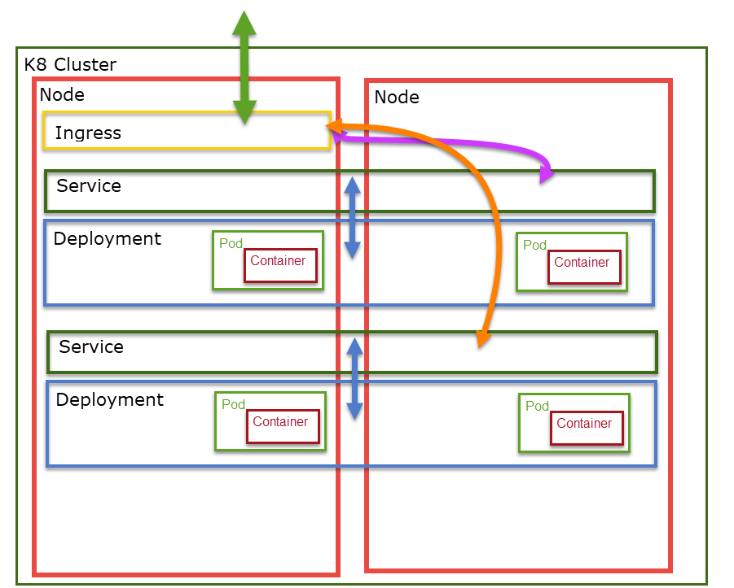
K8 Structure
A K8 Cluster is a collation of Nodes working together.
A Node is a physical or virtual machine in a K8 Cluster for running containers.
An Ingress is a container for bridging communication inside and outside the cluster. Ingresses communicate with Services.
A Service provides a single internal IP address and Domain name for communicating with a Deployment using a Round Robin or other load balancing scheme.

Slide 5
Pods and Containers
Pods usually contain a single container.
In certain special cases, pods can contain multiple containers but when this is the case all containers within a pod always run on the same node.

Slide 6
Deployments and PODS
For most applications, pods are published to k8 as deployments.
A deployment describes
What container image(s)
How many starting pods
Mounted Volumes
Secrets
Other types of Pod and Container configuraiton

Slide 7
Services and Deployments
K8 maintains an internal private network using a non-publicly routable IP range.
Similar to how your home router uses a private ip range and NATs everything in and out over a single IP address.
Services provide a single internal IP address for communicating with a deployment using a load balancing algorithm; usually, round-robin.
Services can be setup with alternate settings such as
Exposing to public network as a port on each Node
Exposing to public network using cloud provider Load Balancer

Slide 8
DNS
Every service has a unique internal domain name based on it’s namespace and service name.
Each service domain name is suffixed with svc.cluster.local
For example, a service named www in namespace default would have a domain name of: www.default.svc.cluster.local
Containers within the same namespace only need to specify the service name in DNS queries.
For example, a background processing container in namespace default would only need to specify www as a DNS query to find the www service also in the default namespace.

Slide 9
Ingress and Service
The typical way to expose a Service/Deployment to the public network or Internet is through an Ingress.
An ingress is a pod that can communicate with the internal and external networks and route traffic between them. A typical use case is a reverse-proxy web server serving traffic from we server containers to the Internet.
A common reverse proxy web server to use in this role is nginx (pronounced Engine-X)
https://www.nginx.com/
https://docs.microsoft.com/en-us/azure/aks/ingress-tls

Slide 10
Ingress and SSL/TLS
Can perform SSL/TLS off-loading. Install the SSL certificate on the ingress and server over port 80 from web containers.
Can cause some issues if web application thinks it is not under HTTPS. May require using some like the following from ASP.NET Core:
app.UseForwardedHeaders(new ForwardedHeadersOptions
{
ForwardedHeaders = ForwardedHeaders.XForwardedHost | ForwardedHeaders.XForwardedProto
});
This tells ASP.NET Core to be aware of and use the XForwardedHost and XForwardedProto headers.
http://bit.ly/2Nc5dWW

Slide 11
Jobs and scheduled jobs
Allow you to schedule a container and guarantee it will run to completion.

Slide 12
Getting Kubernetes
Local Development
Docker for Windows
MiniKube
Cloud
Azure
AKS https://azure.microsoft.com/en-us/services/kubernetes-service/
Amazon AWS
Amazon Elastic Container Service for Kubernetes https://aws.amazon.com/eks
Google Cloud
Google Container Engine https://cloud.google.com/kubernetes-engine/
Install yourself

Slide 13
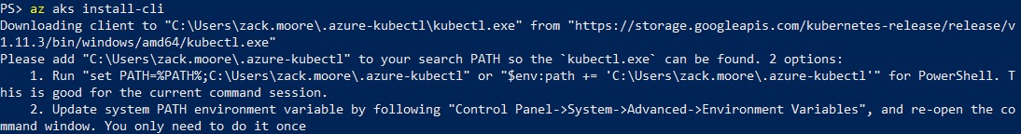
Azure
Skipping ahead b/c Azure CLI has some helpful Kubernetes utilities.
Download and install latest Azure CLI 2 (not Powershell)
https://docs.microsoft.com/en-us/cli/azure/install-azure-cli?view=azure-cli-latest
Login and install Kubectl.exe
Used to drop exe in c:\program files(x86) but now puts it in your profile

